Slide 1



sports Jersey E-SHOPPER
Muluken Deneke | SRS Presentation | Senior Project

Slide 2

Problem Statement
Introduction
The problem of searching and purchasing multiple sport jerseys from multiple websites affects customers.
The impact of which is time consuming, overcostly in money, inconvenient, hard to search and find.
A successful solution would be one website which has multi-sport jerseys available for online shoppers.
Shop All is an e-commerce website that provides the most convenient way to buy sport jerseys.
Shop All has four of the most popular sports (baseball, basketball, Soccer and Football) jerseys all available for purchase on a single website.
Shop All customers are able to save time, money and energy as well as avoid online scammer websites whenever they purchase a jersey.

Slide 3
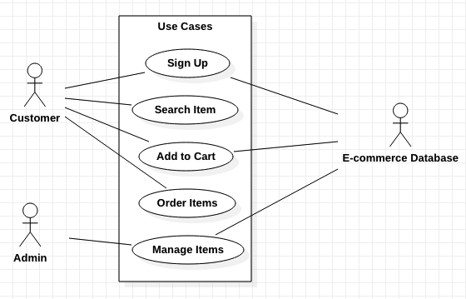
Use-case Diagram

Slide 4
Use-case description
Use case - Customer Orders Items
Flow of Events
Brief Description
This use case allows the customer to order items.
Actors
Customer
Preconditions
Customer is at the home page
Postconditions
System updates inventory in database
Business Rules
User address and Credit card must be valid
Ordered items size and amount must exist in inventory
Nonfunctional requirements - None
User Action | System Response
1. Customer searches an item | 1. List of items is displayed
2. Customer selects an item | 2. System displays items description
3. Customer selects size, and amount then submits order | 3. System adds the items to the Order List and displays payment form
4. Customer fills payment information including shipping address | 4. System process payment information and notifies the customer of successful payment

Slide 5
Key Abstractions
Register | Administrator
Customer | Item
Category | Inventory
Cart | Order
Payment | E-Commerce Database

Slide 6
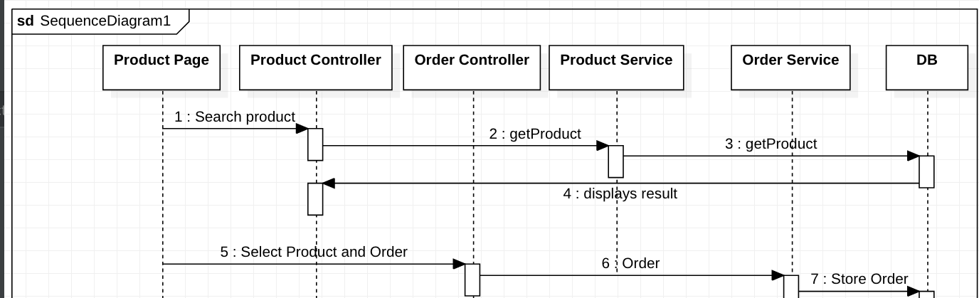
Sequence Diagram

Slide 7
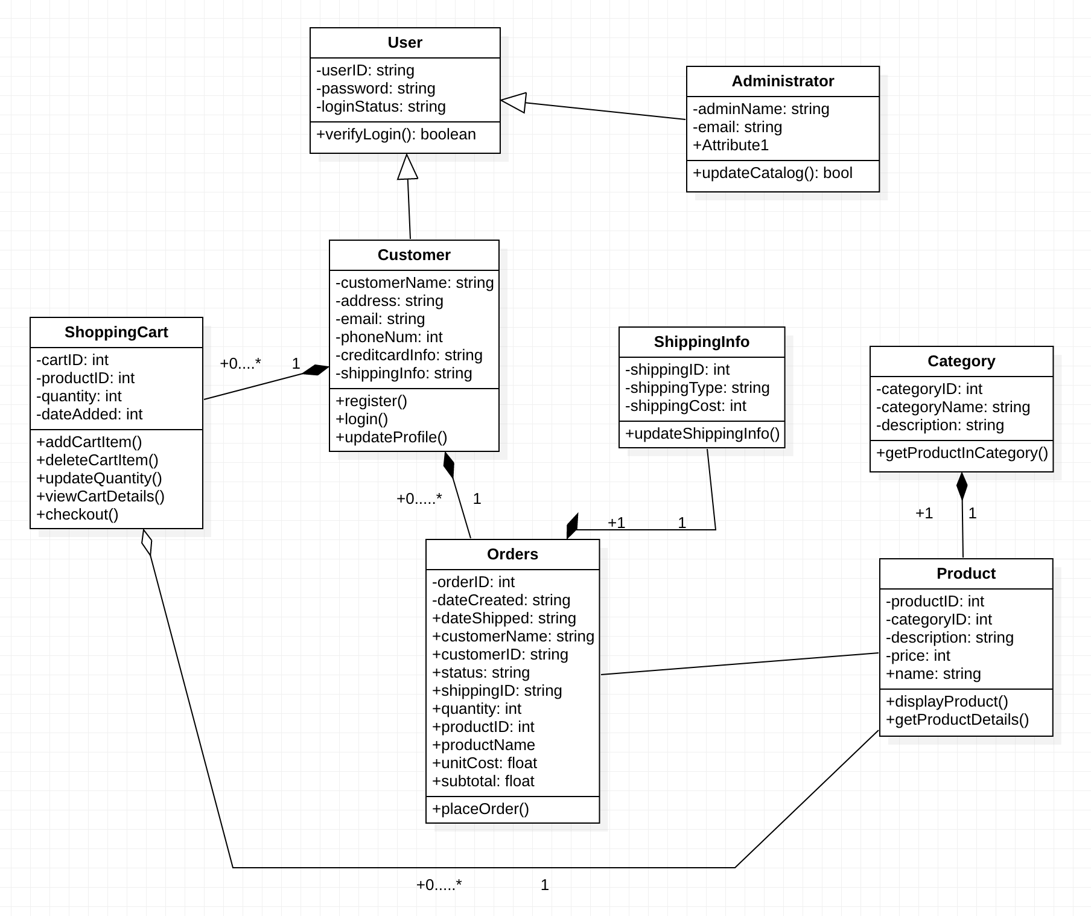
Order Class Diagram

Slide 8
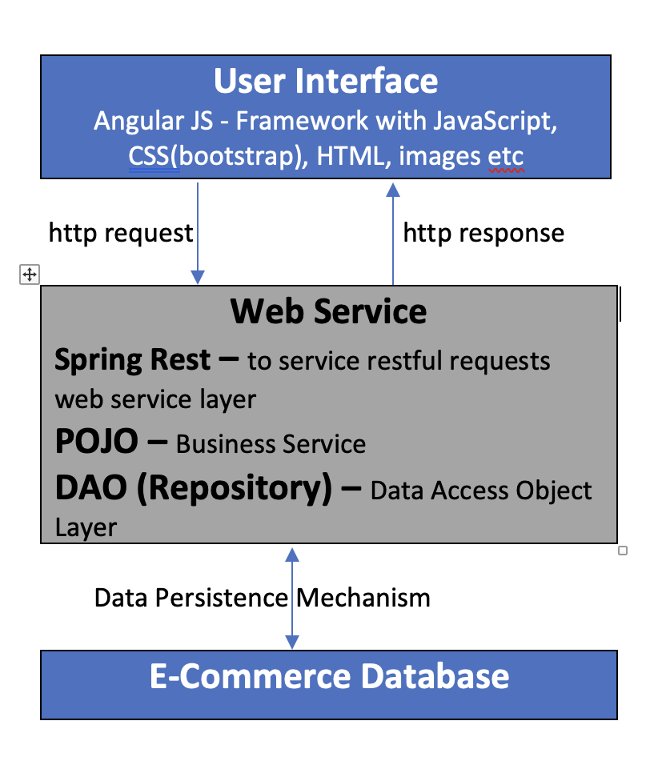
System Layered Architecture

